Slide 1

Project 2
Team MLP*
Wandi
Limin
Rohit
Tze Yi
Ames Housing Project
*My Learning Pony

Slide 2
Problem Statement
Data Scientists within a property agency
As part of our marketing campaign, we are giving advice to house owners / potential buyers
(House owner) What type of features would bring the most value to a specific house?
(Potential Buyers) What features to look out for when purchasing a new house?

Slide 3
Data Science Problem - Predict Ames Housing Prices
Problem Statement
What type of features would best predict the sale of the house?
Concerns to address
What features add the most value to a home?
given a set of features, what is the expected sale price of a house?
given a budget, what kind of house would one be able to afford based on our model?
Notes:
Some negative correlations but it is not strong - enclosed porch

Slide 4
EDA and Data Cleaning Process

Slide 5
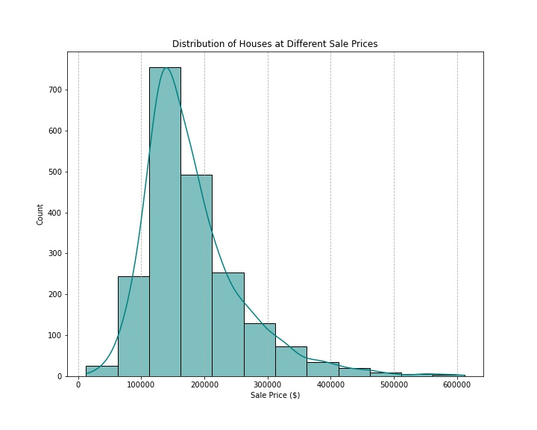
Distribution of House Sales Prices
Based on the data we collect, Ames tends to have houses that are priced around $162,500
Houses that are priced above this amount tend to be more varied in its value than houses below.

Slide 6
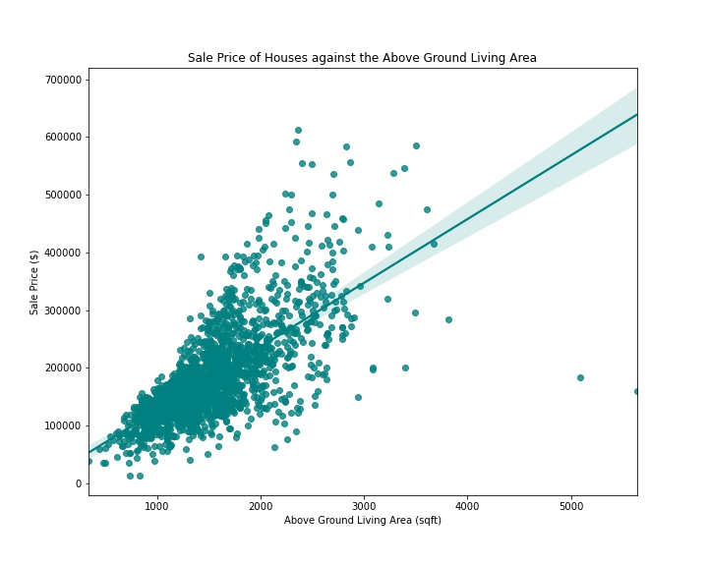
House Size and Sales Price
For every unit increase in above ground living area, sale price increases by about $120.

Slide 7
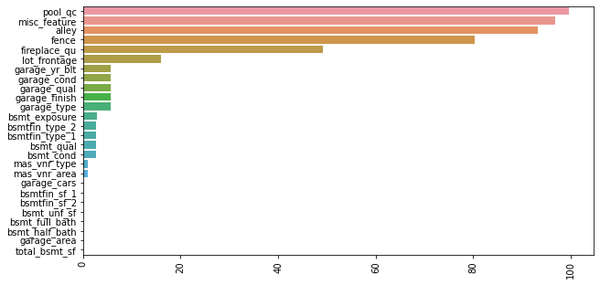
Null Values
In general, most null values represents the absence of a specific feature, hence they are imputed with 0 or ‘None’

Slide 8
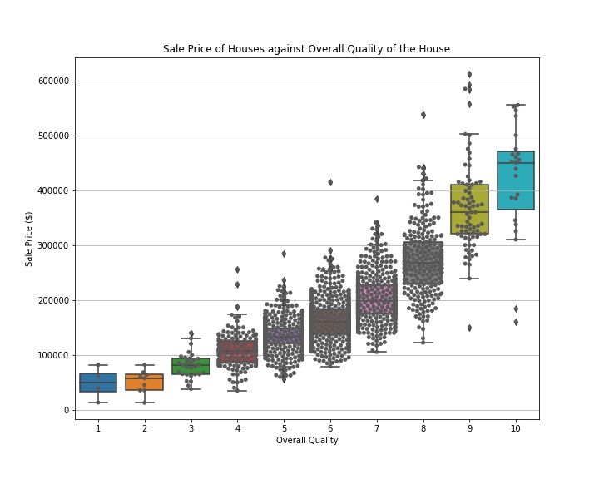
Outliers
5 houses that need to be removed
2 high quality houses, poorly valued
3 partial sale houses
Notes:
Based on the documentation, there are 5 data points that needed to be removed. 2 were high quality houses that were poorly valued and 3 were partial sale houses that do not represent actual market values.

Slide 9
Pre-processing and Modelling

Slide 10
Procedure/Methodology
Any features combined?
total_house_sf
total_porch_sf
total_bathroom
total_bsmt bathrooms
Any interaction terms ? - any investigation done for targets with linear relationships
Neighborhood
Foundation
Garage Type
Ms_subclass
Masonry Veneer Type
Any collinearity observed and what was dropped because of it?
External condition
Notes:
Summary of Changes done:
1. Minmax scalar to be applied within the notebook so that it can be inverted if need be
2. id , pid and Unnamed: 0 dropped
3. Since both garage car and garage area measured the same thing in diff units, only garage area was kept as it was more correlated with saleprice
4. ext_qual,fence, pool_qc fireplace_qu, kitchen_qual and bsmt_qual were dropped as they were very highly correlated to overall qual, meaning over qual is likely the lurking variable behind these 3 values.
5. exter_cond dropped as it was quite strongly correlated with overall_cond which was the variable selected by our model to be predictive of saleprice. After dropping, it left us with a fairly independent variable which will likely benefit our model's predictive power.
6. Summary of features engineered and dropped below:
- Feature 1 : total_house_sf = accounts for all sf of the house
- Features dropped - 1st_flr_sf ; 2nd_flr_sf; total_bsmt_sf; gr_liv_area
- Feature 2 : total_porch_sf
- Features dropped - open_porch_sf; 3ssn_porch; enclosed_porch; screen_porch
- Feature 3 :total_bathrooms
- Features dropped - full_bath; half_bath
- Feature 4 :total_bsmt_bathrooms
- Features dropped - bsmt_full_bath; bsmt_half_bath
2 tests:
For numerical features, correlation checks were done against sale price.
For Categorical variables, 2 tests were done:
Ran a Kruskal Wallis test on highest correlated variable to overall quality ratings which is an ordinal variable
found that distribution the median quality rating of 6 had 0% probability of being representative of population
To account for this,, a log transformation was done for skewed values before modelling
a one-way ANOVA was done to assess relationship between remaining features and saleprice.
Found that the most correlated value is neighbourhood, followed by foundation, garage type, ms_subclass (which is housing type) and masonry veneer type.

Slide 11
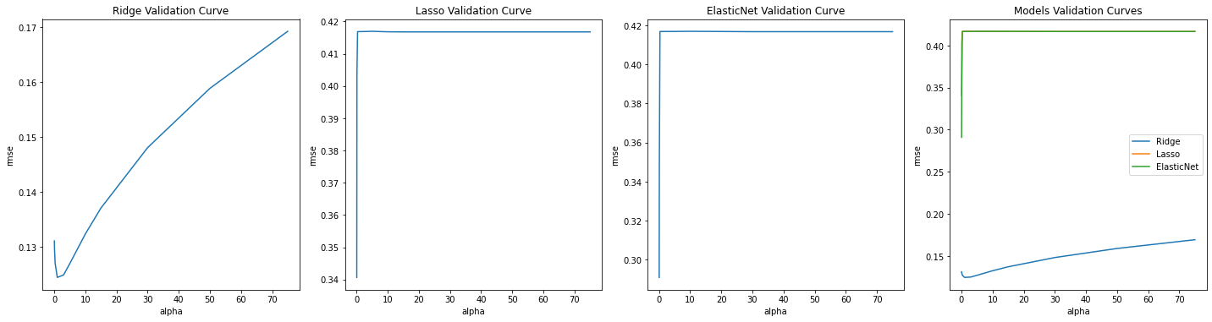
Hyper parameter selection
Notes:
Base on the results of our plot, the Ridge regression is the best performing model at alpha 0.5, giving us a RMSE score of 0.13.
Given our understanding of how the Ridge model works, this likely means that all our features contribute to sale price, which is why LASSO and Elastic Net did not work as well.

Slide 12
Primary Findings
Overall, the top 10 features selected by the model to be most predictive mostly applied to the following areas:
House size
Overall quality and condition ratings
Home functionality
Neighbourhood
Notes:
Number of features before ridge: 229
Number of features after fitting ridge: 147
variable coef abs_coef
9 overall_qual 0.592373 0.592373
29 gr_liv_area 0.571605 0.571605
26 1st_flr_sf 0.484239 0.484239
10 overall_cond 0.396553 0.396553
38 functional 0.390332 0.390332
4 lot_area 0.277303 0.277303
24 total_bsmt_sf 0.237529 0.237529
46 garage_cond 0.212081 0.212081
93 neighborhood_grnhill 0.211033 0.211033
20 bsmtfin_sf_1 0.202314 0.202314

Slide 13
Business Recommendations

Slide 14
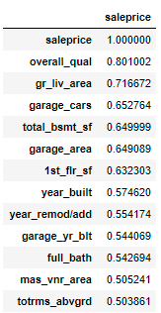
Recommendations
Which features appear to add the most value to a home?
Overall Quality & Above Ground Living Area
Which features hurt the value of a home the most?
No one features strongly negative impact housing price

Slide 15
Recommendations
What are things that homeowners could improve in their homes to increase the value?
By identifying important features of the house, owners may decide to renovate the house:
Garage
Basement
Kitchens
Bathrooms
Masonry Veneers
Notes:
For improvement, try give examples that will focus on improving and increase value of the house

Slide 16

Recommendations
Edwards
What neighborhoods seem like they might be a good investment?
Current no. of houses (high population)
Price of houses at sale (low sale price)
Current Top 3 areas:
Northridge Heights
Stone Brook
Northridge
Old Town
Sawyer
Notes:
For improvement, try give examples that will focus on improving and increase value of the house

Slide 17
Recommendations
Edwards
House Population: 143
Price: $ 130,493.468531
Sawyer
House Population: 111
Price: $ 137,181.909910
Old Town
House Population: 163
Price: $ 125,276.300613
Notes:
For improvement, try give examples that will focus on improving and increase value of the house

Slide 18
Recommendations
Do you feel that this model will generalize to other cities? How could you revise your model to make it more universal OR what date would you need from another city to make a comparable model?
The model is able to generalize other cities but recommended that they have their own set of housing data for detailed analysis
Notes:
For improvement, try give examples that will focus on improving and increase value of the house

Slide 19
Conclusion*
House predictions are affected by a myriad of factors that may not be represented in our dataset. Please use our model as a guideline instead of gospel. Thank you.
*Disclaimer
*T&C’s apply

Slide 20
Thank You!
Q&A

